Slide 1
GetActive

Slide 2
Project Vision
Many students struggle to make new friends due to a lack of simple tools for social engagement. GetActive is a platform designed to help students stay socially active by discovering and participating in group activities. Our goal is to enhance student life and build a stronger campus community.
Notes:
JIE

Slide 3
GetActive Team
Team Lead
Jin Hao Li
Arshdeep Dhillon
Requirement lead
Jie Shi
Design and implementation lead
Jin Hao Li
Arshdeep Dhillon
QA lead
Team
Configuration lead
Shaohua Yue
Arshdeep Dhillon
Security lead
Arshdeep Dhillon
Notes:
JIE

Slide 4
Iteration 3 Overview
In this Iteration, we
Finalize the homepage layout and visual elements.
Implemented the Roster Display functionality.
Implemented the Admin Edit & Save functionality.
Implemented the Delete Activity functionality.
Implemented the User Avatar functionality.
Implement the Activity Comments functionality. (Still in process)
Implement the Popularity Sort functionality. (Still in process)
Notes:
JIE

Slide 5
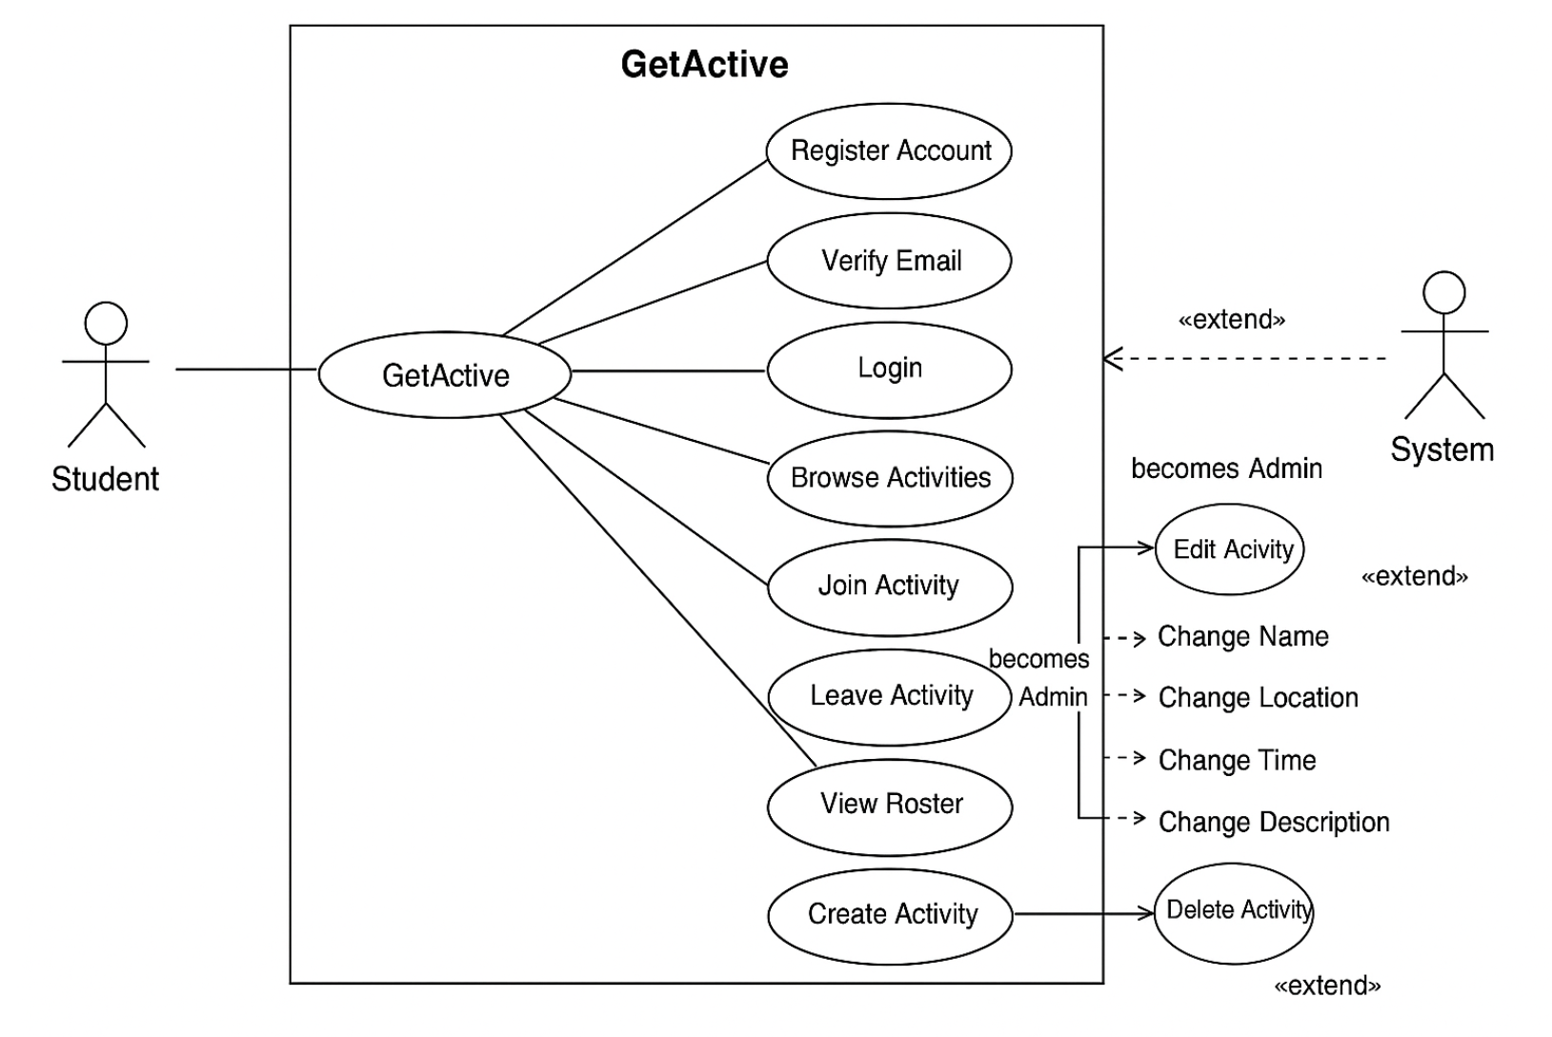
Functional Requirements Overview
In our requirement analysis, we first identified key functional needs using a use case diagram.
As a new student, I want to create an account with my BU email address, display name, and password, so that I can access the platform with an identity that’s shown publicly by name but secured by my BU email.
As a returning student, I want to log in with my BU email and password, so that I can access my activities and profile securely.
Notes:
JIE

Slide 6
Relevant Iteration Metrics
Total number of planned user stories: 27
Essential Features
Desirable Features
Optional Features
Nonfunctional Requirements
Number of user stories completed: 14
Notes:
JIE

Slide 7
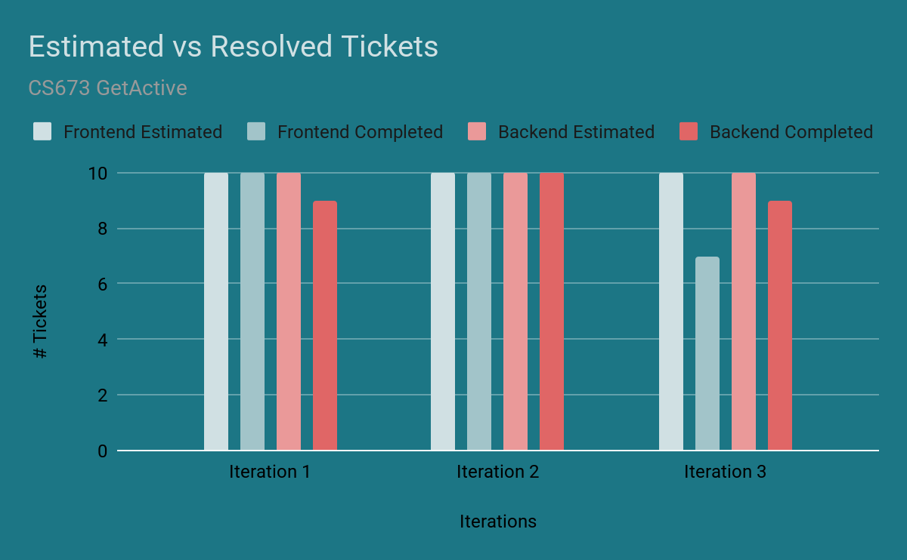
Project Timeline
Notes:
JIE

Slide 8
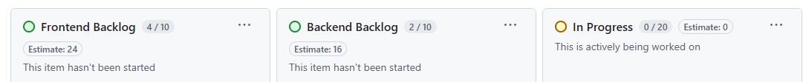

KanBan Board
New GitHub Issues created at the start of each iteration
Issues added to GitHub Project Kanban
Standup meetings: team members self-assign tasks based on interest/skill
PRs linked to Issues for traceability and code review
During the development of our project, we used GitHub Projects’ Kanban board to track and manage all functional requirements and user stories. We structured the board into six main columns.

Slide 9
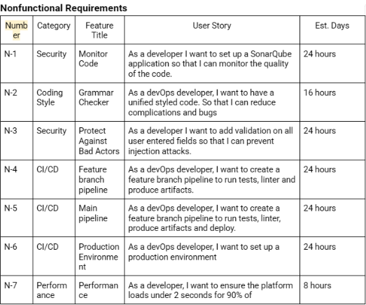
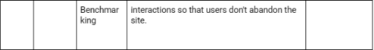
Nonfunctional Requirements
Performance
Usability
Security
Reliability
Scalability
Notes:
JIE

Slide 10
Project Management
Meet twice a week for standup and one meeting for deliverables
Timeline
Iteration 1: 4 Essential Features and CI/CD pipeline
Iteration 2: 4 Essential Features
Iteration 3: Desirable Features
Achievements
All essential features implemented
CI/CD implemented using Git Action
Notes:
Jin

Slide 11
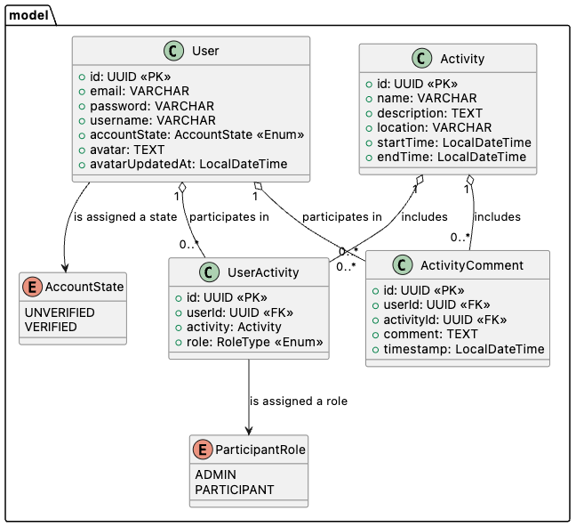
Design
Notes:
Jin

Slide 12
Implementation(Tools)
IDE: Visual Code
Source Control: Git
CI/CD Pipeline: Git Action
Backend Framework: Spring Boot
Frontend Framework: React
Automated Testing: JUnit, Cypress, Vitest, React Testing Library

Slide 13
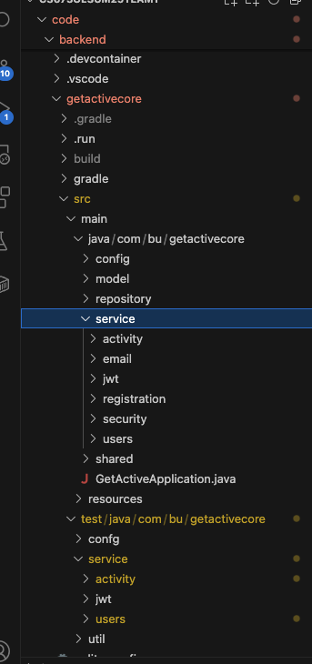
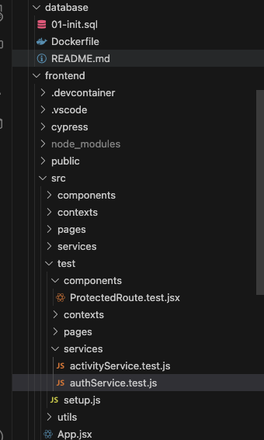
Implementation (Project Structure)

Slide 14
Security in Requirements
Authentication required for access to protected REST APIs.
Only verified users can access certain endpoints.
Unauthorized users must not see error messages that leak internal info.
Passwords must be securely stored and never retrievable.
Token-based authentication required for stateless communication.
Notes:
Arsh: non-functional security requirements

Slide 15
Security in Design
Used JWT for stateless authentication.
Defined public vs protected endpoints via route whitelisting.
/v1/register/
/v1/register/confirmation
/v1/register/confirmation/resend
Designed custom Spring filter to validate tokens before hitting business logic.
Defined roles & privileges using Spring Security method-level annotations using PreAuthorize.
Eg: Only admin users can modify their own activity.
/v1/*
Notes:
Arsh: secure by design: threat modeling and architecture decisions

Slide 16
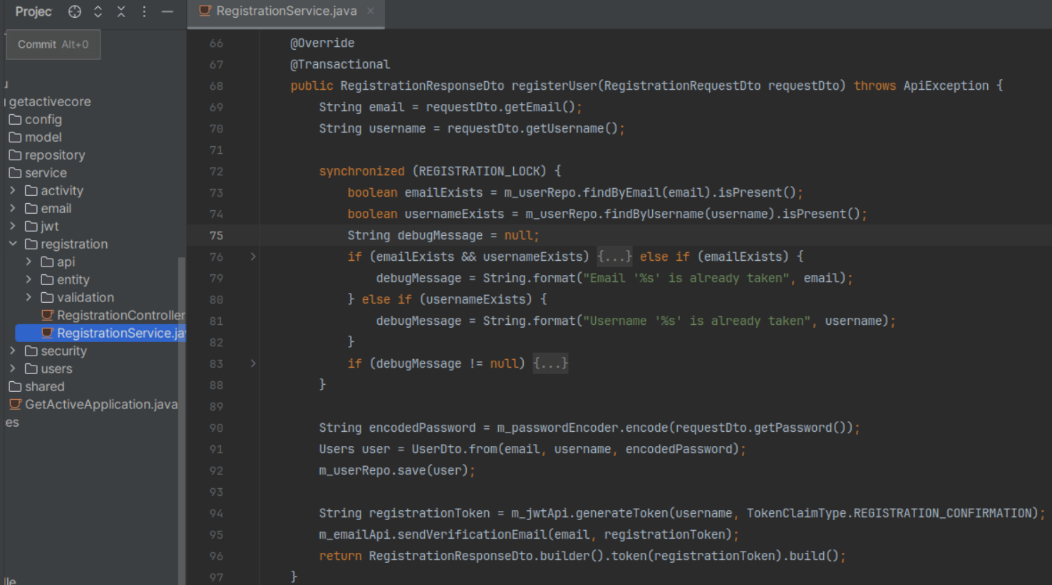
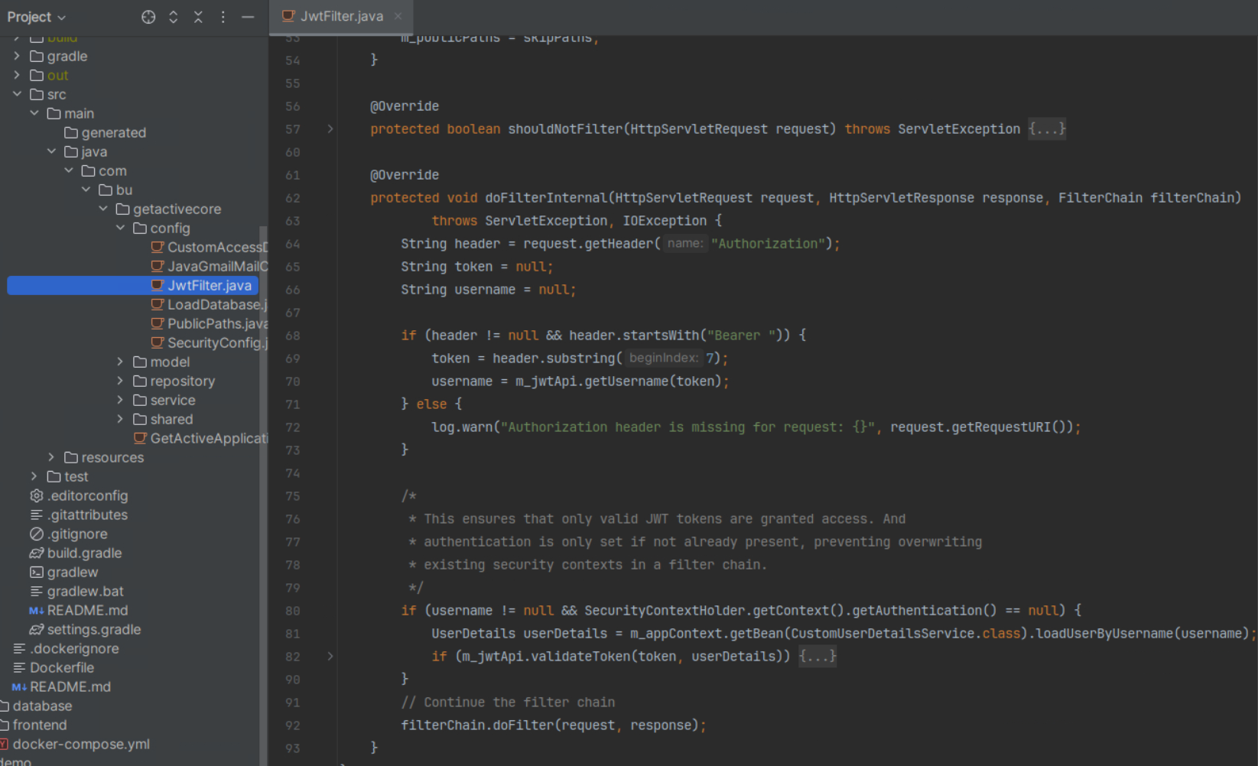
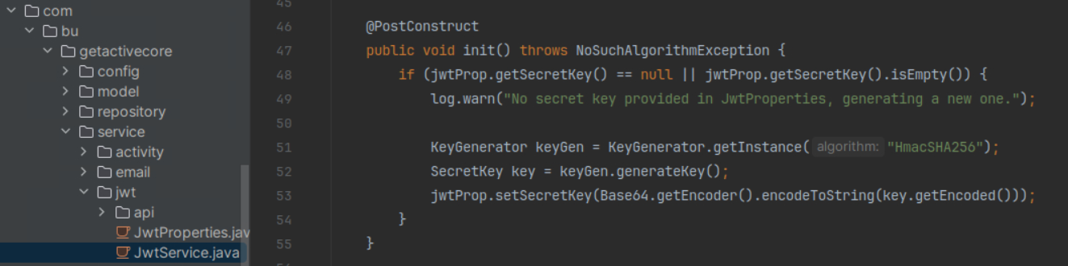
Security in Implementation
Passwords stored using BCrypt hashing.
JWT signing key created at startup.
Used custom JWTFilter Spring filter to authenticate the incoming requests.
Notes:
Arsh: security enforcement via code and configuration Spring Security configured with:
Stateless session management.
CORS rules (currently open).
CSRF disabled (REST API).

Slide 17
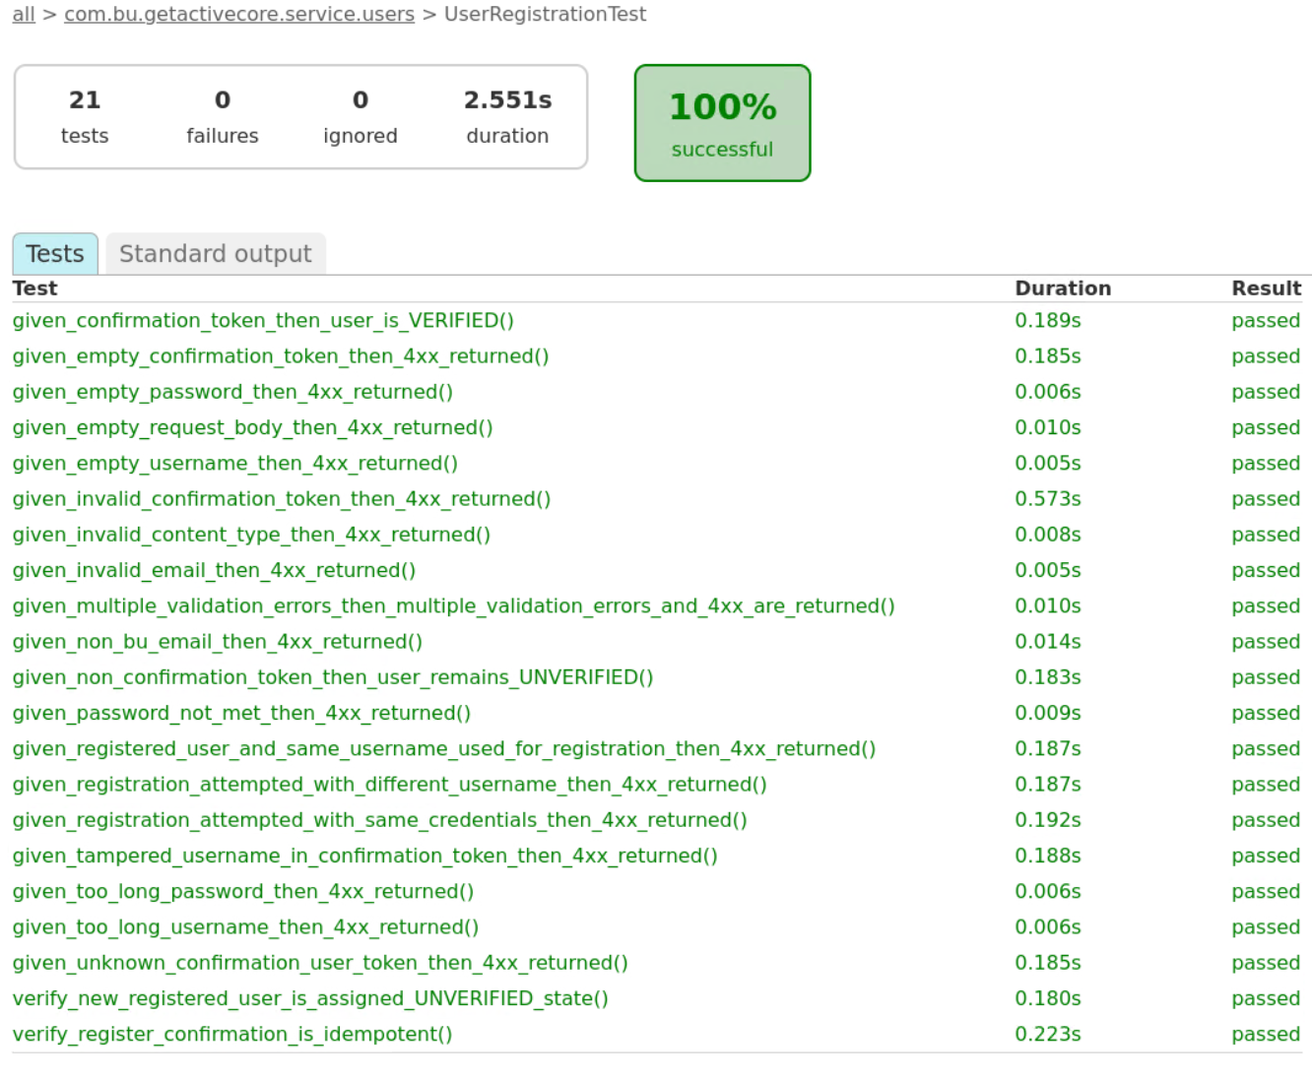
Security in Testing
Manual Postman testing of JWT authentication and permission boundaries.
Used Spring MockMvc for end-to-end authentication behavior testing.
Notes:
Arsh: validating protection boundaries

Slide 18
Deployment
Platform:
AWS EC2
Elastic IP Address
Flow:
Create a tag for a commit
Create docker images: database, backend, frontend
Upload images into Github Container Registry.
Log into production instance to download and deploy.
Security:
Two separated network
Only expose necessary port
Secrete credentials
Site: http://3.131.225.218/login
Notes:
Shaohua

Slide 19
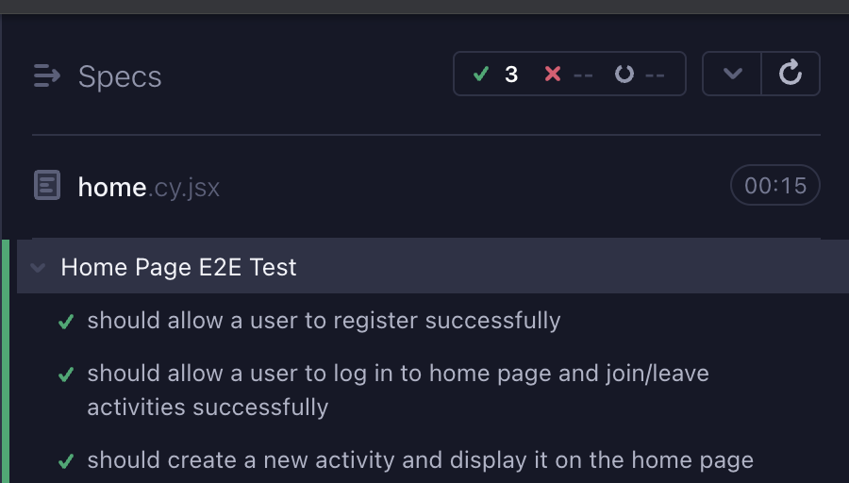
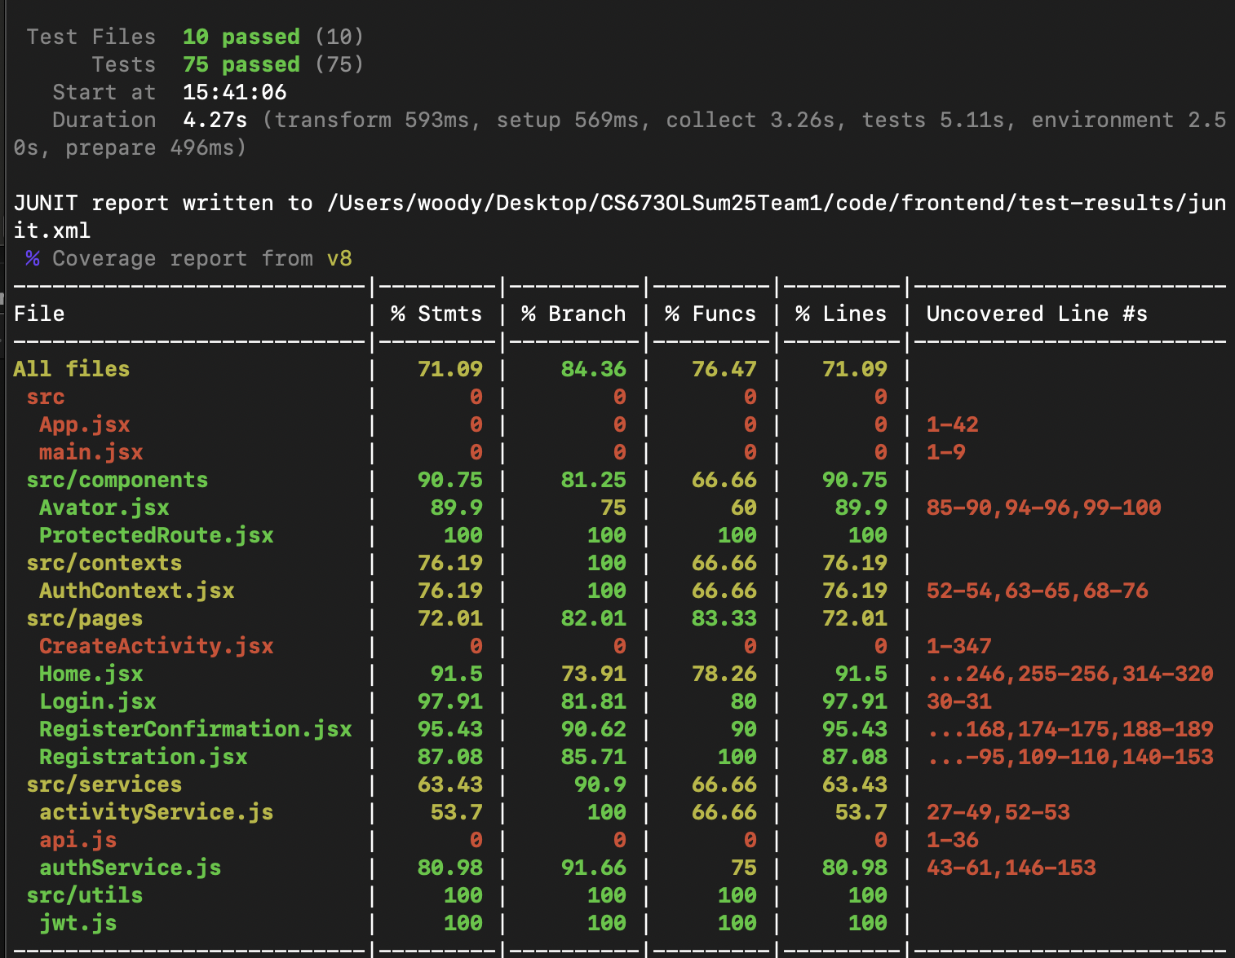
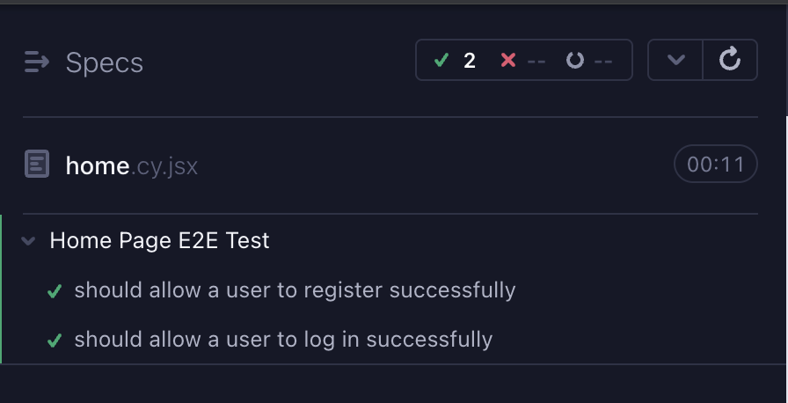
Frontend testing & Coverage(Vitest,RTL)
E2E tests
Unit tests
Notes:
Shaohua

Slide 20
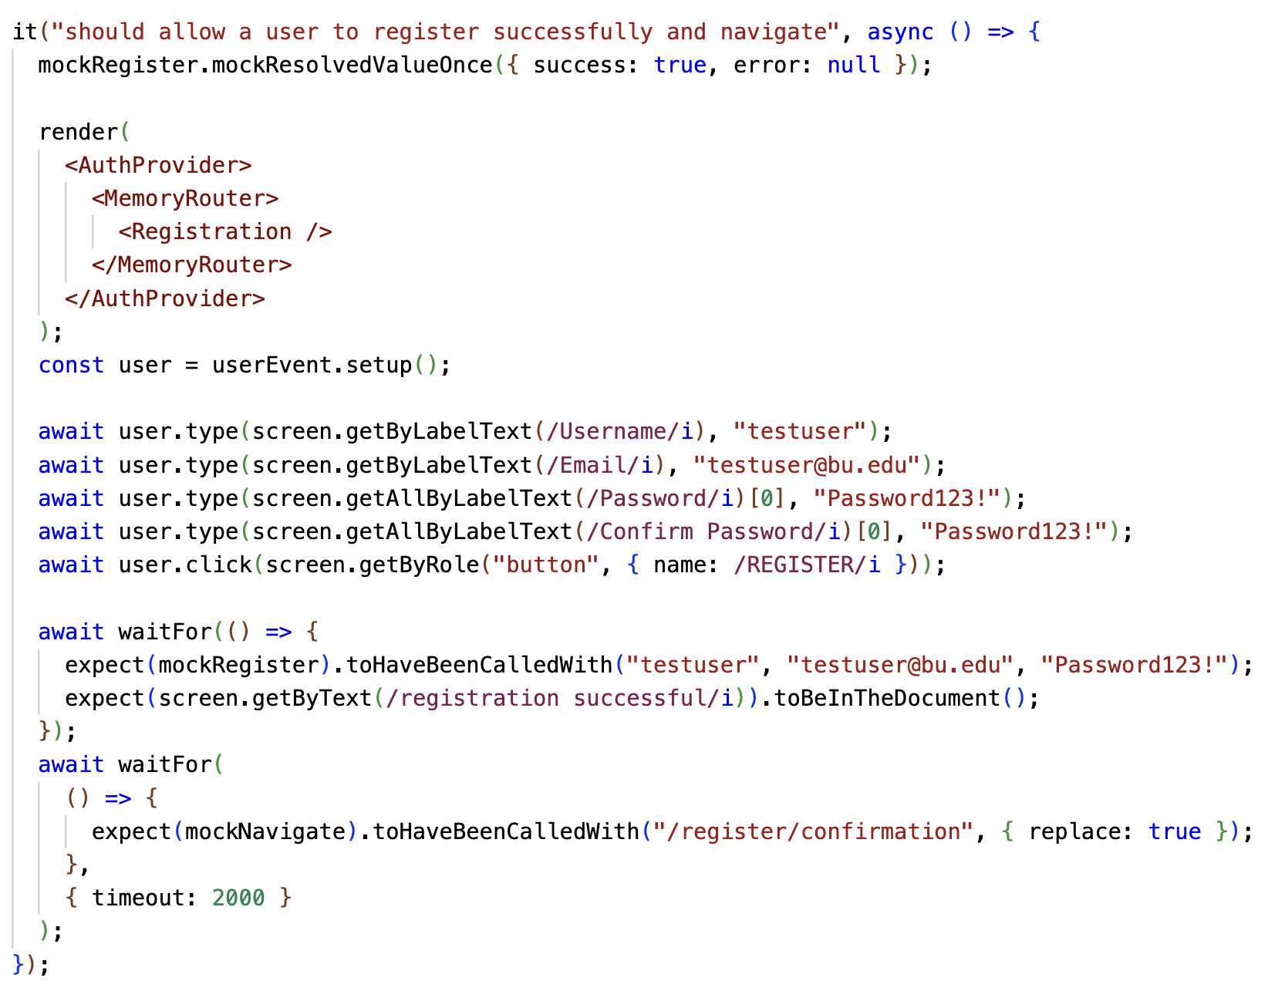
Frontend Unit test Example

Slide 21
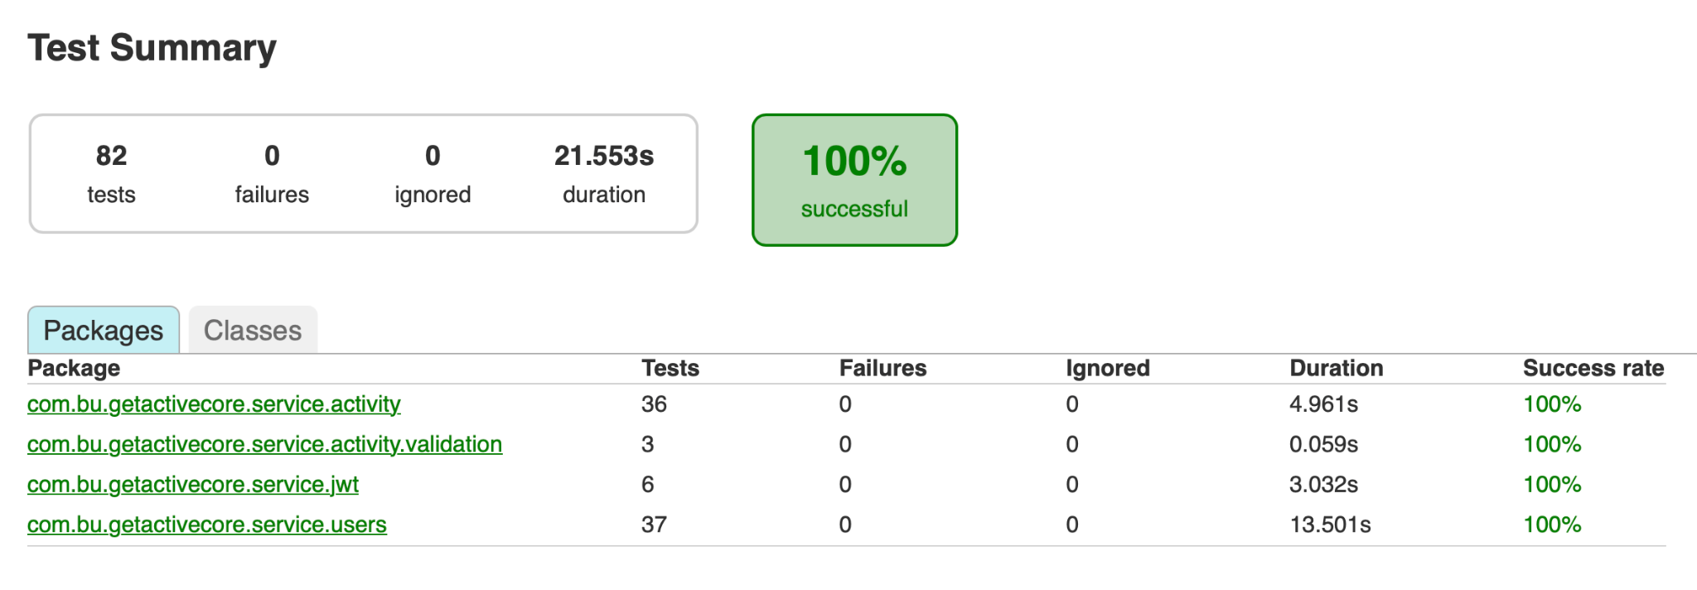
Backend Testing(JUnit,Mockito)
Notes:
Shaohua

Slide 22
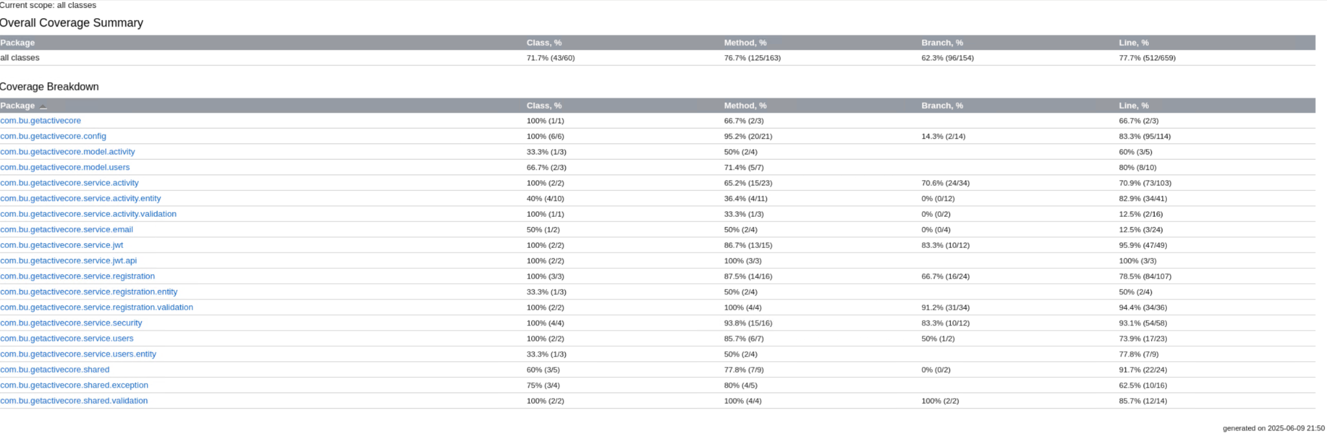
Backend Testing Coverage
Notes:
Shaohua

Slide 23
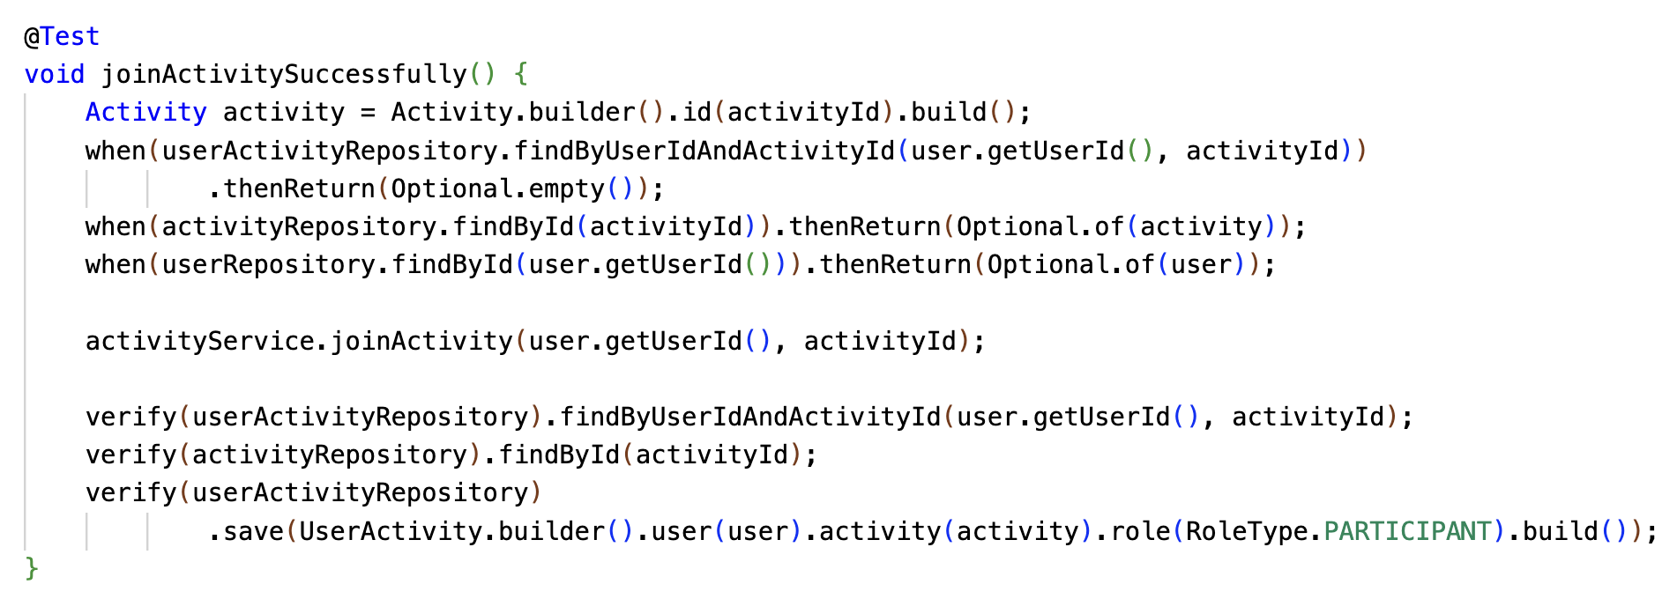
Backend Unit Testing Example

Slide 24
Manual Testing
Allow user to change their avatar
System should lead user to login page after token expired
System should stay in home page after user refresh the home page
Account Registration
Create/Delete Activity
Join/Leave Activity
Notes:
Shaohua

